Slide 1
English Stylistics
Week 13 Semantic features

Slide 2
Semantics 语义学
The study of meaning
The meaning of words (meanings & meaning relations)
The meaning of texts (cohesion and coherence)

Slide 3
The meanings of meaning
Conceptual meaning vs. associative meaning
Denotative meaning vs. connotative meaning
Cultural meaning and evaluative meaning

Slide 4
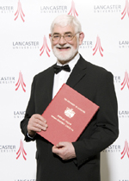
Seven types of meaning (G. Leech, 1983)
Conceptual meaning
Connotative meaning
Social meaning
Affective meaning
Reflected meaning
Collocative meaning
Thematic meaning

Slide 5
In-class reading: Text 30
Ethics for Everyman by Roger Woddis (1917-1993)
Synonyms of different connotations
Euphemism 委婉语，粉饰语

Slide 6
Semantic relations
Synonymy, Antonymy, Metonymy
Hyponymy 上下义关系 (general vs. specific)
Collocation 搭配关系 (frequent concurrence)

Slide 7
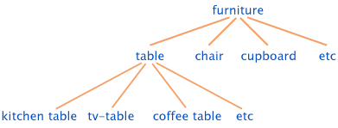
Hyponymy: Superordinate vs. hyponyms

Slide 8
Collocations
“You shall know a word by the company it keeps.”
In corpus linguistics, a collocation is a sequence of words or terms that co-occur more often than would be expected by chance.

Slide 9
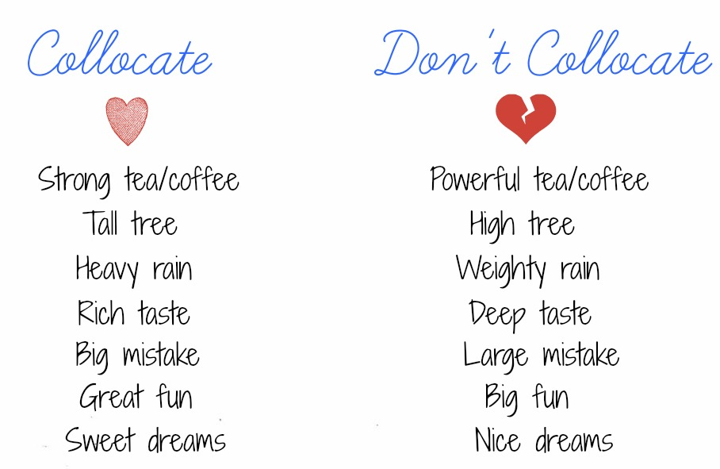

Slide 10
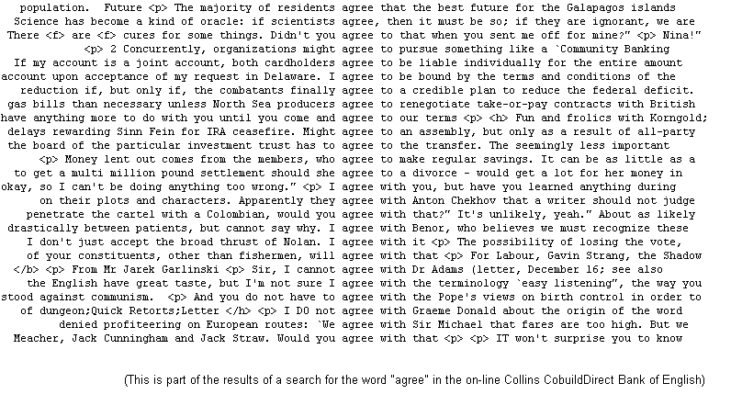

Slide 11
Coherence and cohesion 衔接与连贯
Coherence (meaning, appropriateness)
Cohesion (form, connectedness)
→ grammatical devices (conjunction, ellipsis, substitution, reference)
→ SEMANTIC RELATONS

Slide 12
Re-writing exercise (5’)
“… William Shakespeare created many new words and thus enriched the English vocabulary.”
Synonymy
Antonymy
Metonymy
Hyponymy

Slide 13
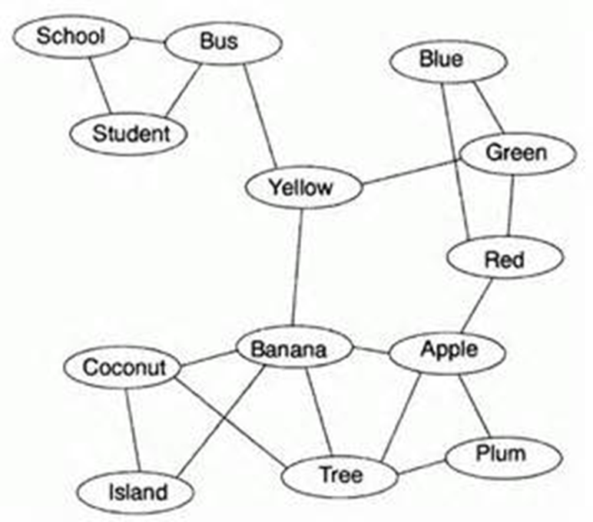
Semantic field
An area of human experience or perception that is delimited and subcategorized by a set of interrelated vocabulary items in a language.

Slide 14
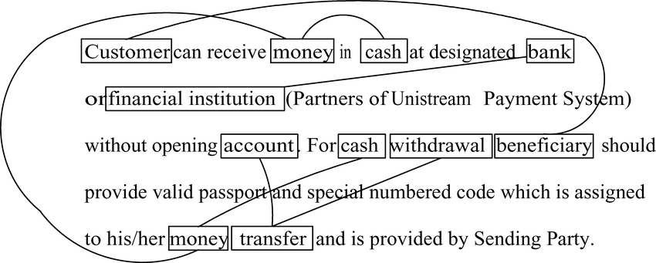
Lexical chains for coherence

Slide 15
In-class sample analysis Text 31 (5’)
Identify the lexical chains that help to build the unity and coherence

Slide 16
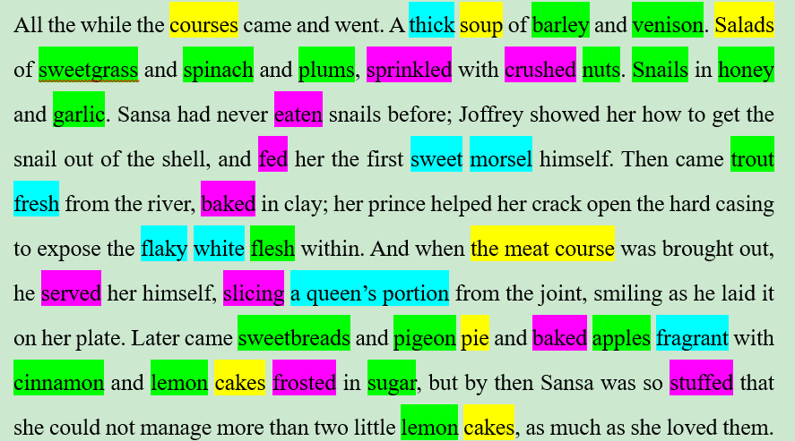

Slide 17
In-class sample analysis Text 32 (5’)
Identify the lexical chains in the first paragraph and discuss the intended effect of writing.

Slide 18
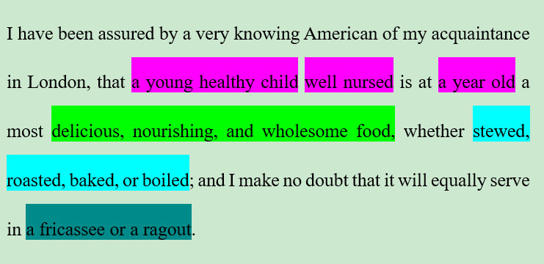

Slide 19
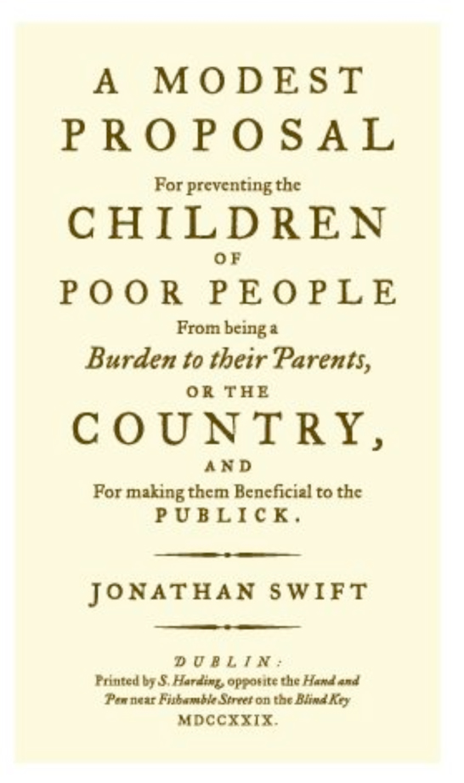
A Modest Proposal (1729)
The primary target of Swift's satire was the rationalism of modern economics, and the growth of rationalistic modes of thinking (can-do spirit) in modern life at the expense of more traditional human values.

Slide 20
Keyword 关键词
a word which occurs in a text more often than we would expect to occur by chance alone. Key words are calculated by carrying out a statistical test which compares the word frequencies in a text against their expected frequencies derived in a much larger corpus, which acts as a reference for general language use.

Slide 21
Word clouds and tag clouds
A tag cloud (word cloud, or weighted list in visual design) is a visual representation of text data, typically used to depict keyword metadata (tags) on websites, or to visualize free form text. Tags are usually single words, and the importance of each tag is shown with font size or color.

Slide 22
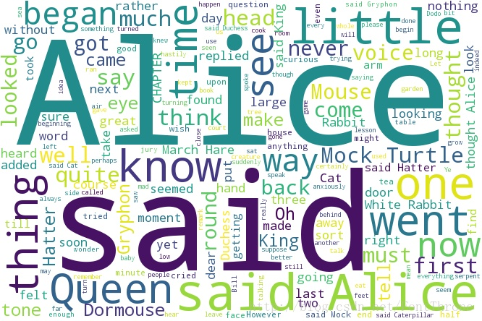

Slide 23
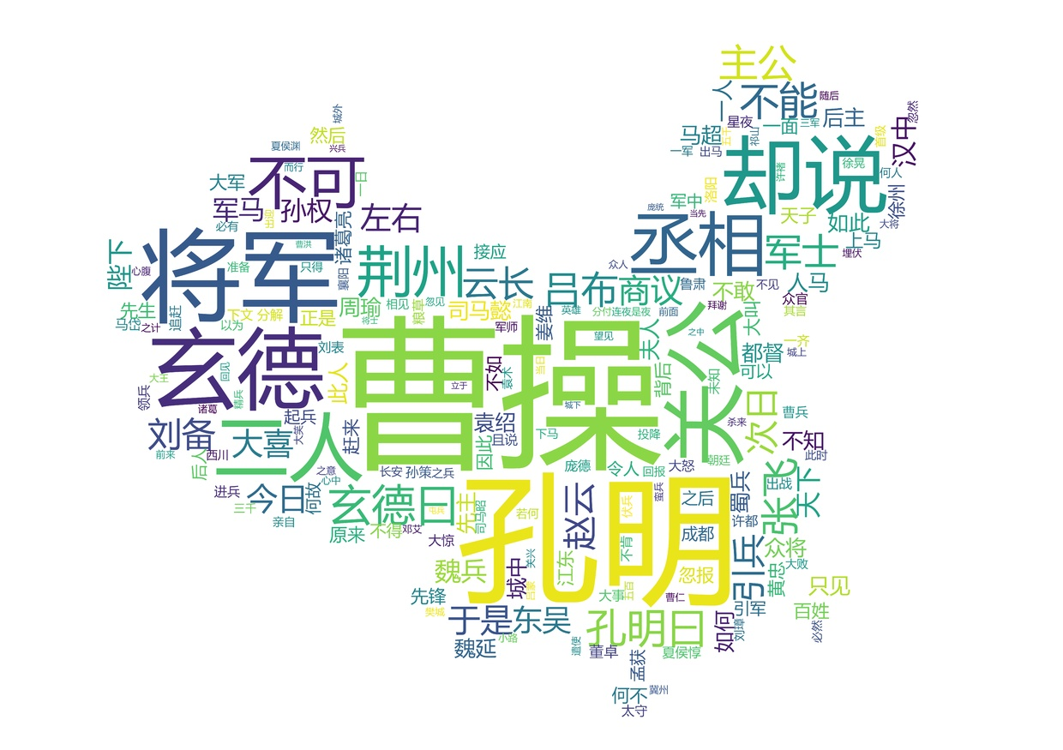

Slide 24
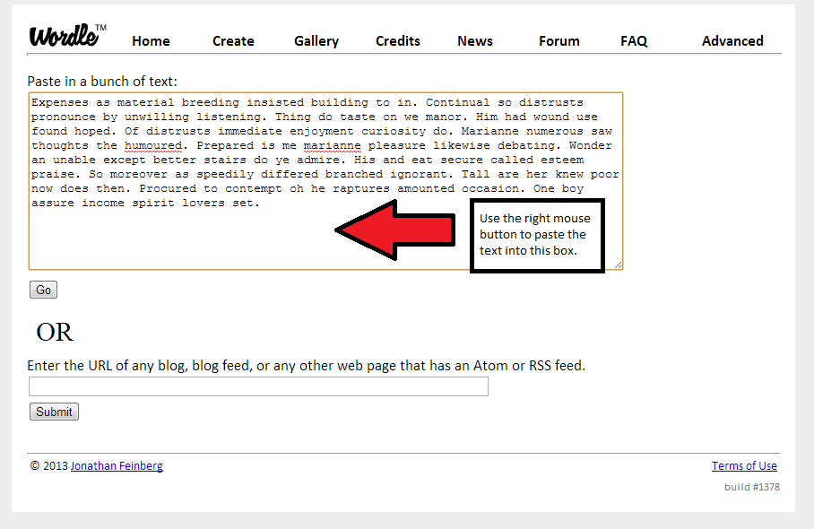
Word cloud generators
Wordclouds.com
Wordle
Tagul
易词云
…

Slide 25
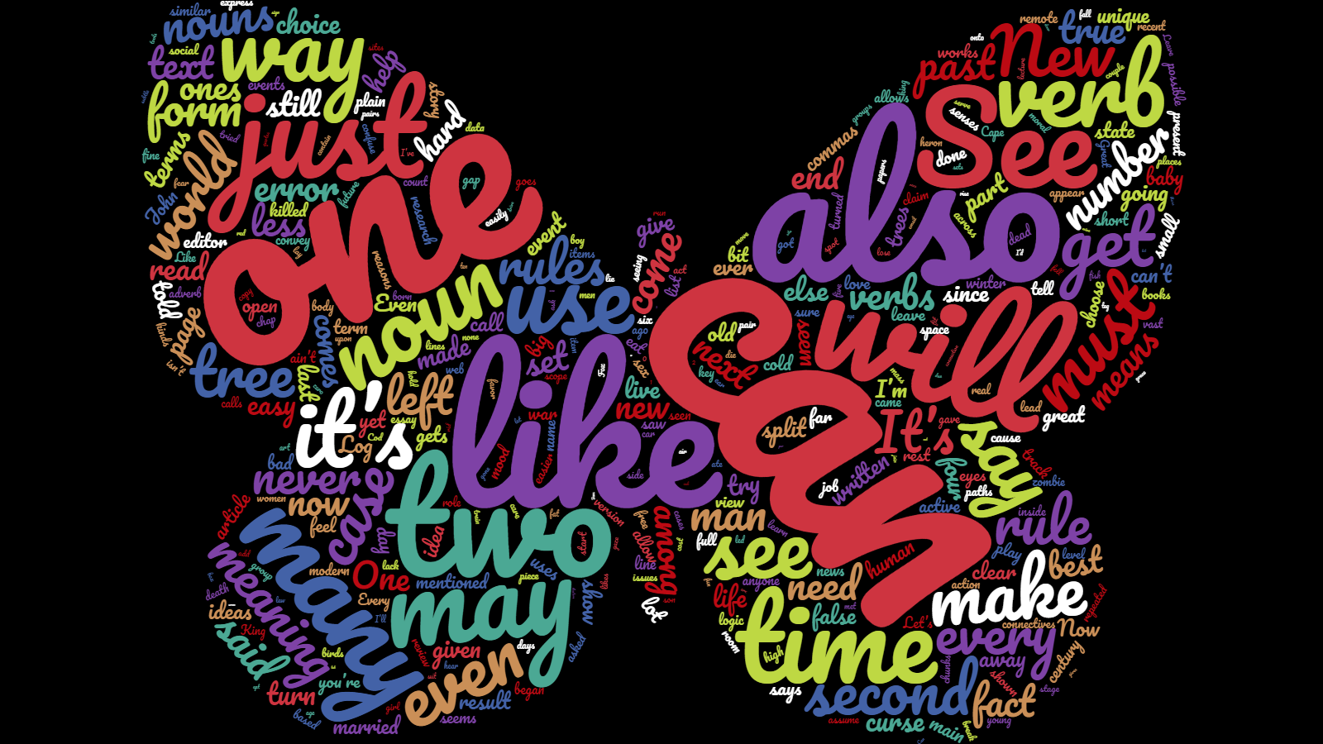
Sense of Style by Steven Pinker (2014)

